Slide 1
Relate
Collaborating and communicating with impact: embracing the technological shift
Chris Sherwood, Chief Executive – Relate
Chris.Sherwood@relate.org.uk
@ChrisSherwood80

Slide 2
Technology is disrupting our relationships
Notes:
Why do we need to change?
“Social relationships are being reconfigured through the internet.”
“Merely having a phone visible in the room—even if no one checked it—made people less likely to develop a sense of intimacy and empathetic understanding during meaningful conversations.” – University of Essex study, 2012
Key trends in our market:
Public spending restraint, which has resulted in rationing of public services and cuts to discretionary spending, which have hit Relate hard with a reduction in our income from local government and health by 26% over the last parliament.
Increased demand for counselling and psychotherapy in the UK; BACP estimates that the number of people who have accessed counselling has increased from 20% of the adult population to 28% over recent years.
Technology, which is changing the way we find, organise and even end our relationships but is also changing the way people want to access and use services, and in particular for millennials (people born in the early 1980s to 2000)who will be the future users of our services.
The structure and way we organise our relationships is changing, for example co-habiting couples with children are the fastest rising household unit, followed by lone parent households. Today, we also see a greater diversity of relationships than ever before including equal marriage, couples who live together apart and open relationships.
Counselling is increasingly seen as a vocational career route, rather than a philanthropic endeavor. Universities and other providers are producing ready qualified counsellors who want to work for us, often full time. The number of counsellors is also increasing (and have higher expectations for pay and conditions), which means that we face greater competition in a growing market for relationship support.

Slide 3
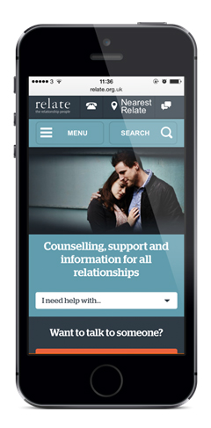
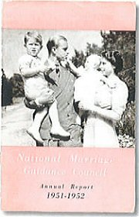
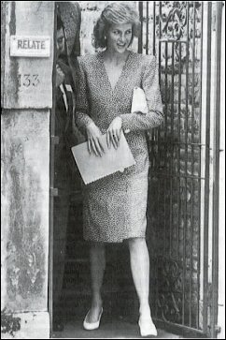
…and how people access our support
Notes:
Relate has been changing for 78 years.
More than 50% online, high growth – online services
Not the National Marriage Guidance Council

Slide 4
Governance
Governance
Notes:
Good governance – high challenge, high support
Performance as well as conformance – strategic, horizon scanning
Appetite for risk
Strategy review – key barrier for us moving forward

Slide 5
Innovation

Slide 6
Money
Money

Slide 7
“We had no office, no funds, no precedent to guide us… just an inescapable conviction that this ought to be done, and that nobody else was trying.”
Herbert Gray, our founder said this afterwards
Notes:
Building a bigger, better, bolder Relate so that we can go on to support more relationships in the future.
This matters because Relate makes a unique contribution to our society etc.
We want to go on providing good quality services to individuals, couples, families and young people.

Slide 8
Thank you
chris.sherwood@relate.org.uk
@RelateChris

